Slide 1
Digicoffer Personal
Test Cases

Slide 2
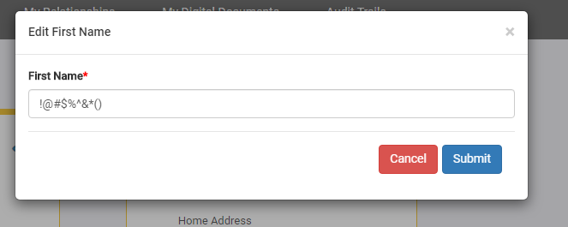
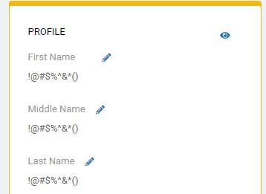
My Profile Page
Edit name Issue
Fields of First name , Middle Name and Last name are taking invalid values.
Field should take alpha-numeric values

Slide 3
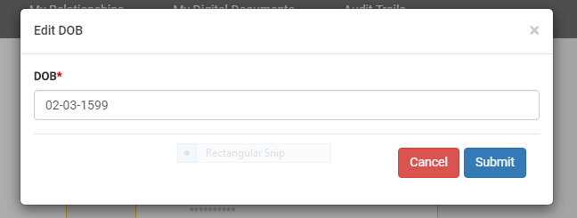

My Profile Page
Date of Birth Issue
DOB field is taking 500+ years back Date.
DOB cannot be that old

Slide 4
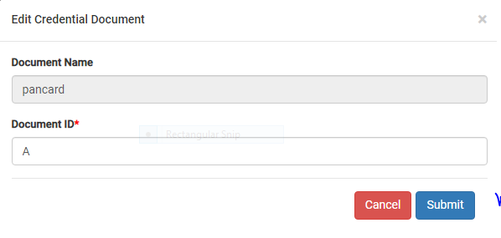
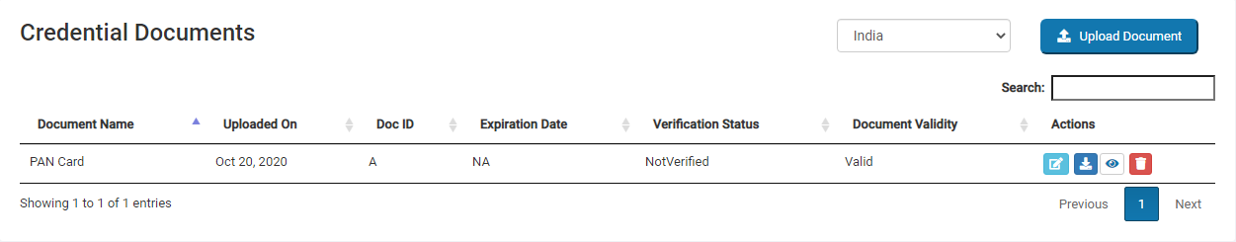
My Digital Documents Page
Edit Credential documents
Document ID field is accepting the wrong ID format after editing and submitting.
No error message is shown
And It is updating the field in credential document page
here
here

Slide 5
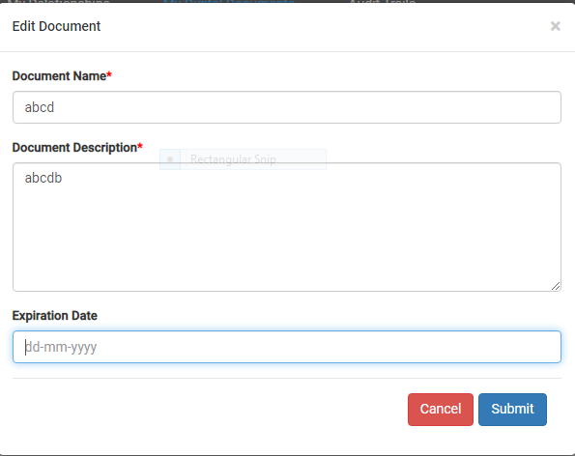
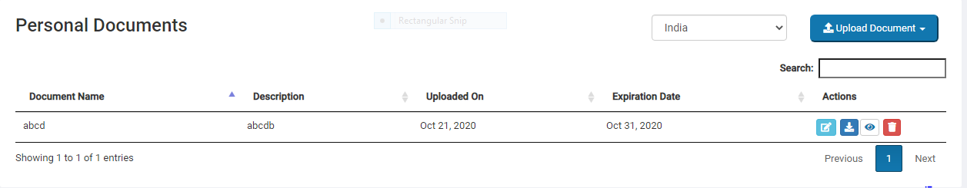
Personal Document Page
Edit Document
Even after removing Expiration date and submitting , Date is not removed in Updated page of Personal Document.
here

Slide 6
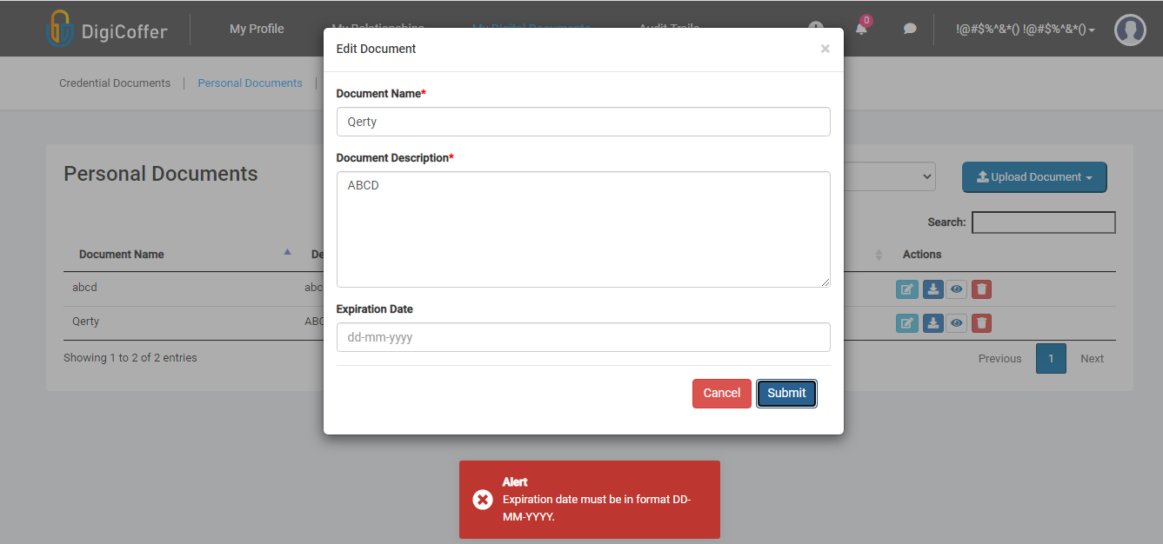
Personal Document Page
Edit Document
Click on edit(pencil button), Edit Document page will be open.
Click on submit.
We cannot submit. Alert message is shown as “Expiration date must be in MMM DD, YYYY”

